Slide 1

Proficient data transmission in underwater wireless sensor networks with networking simulator
Presented by
B.PRAVEN KUMAR REDDY
Under the guidance of
Name: Dr.J.V.ANAND
M.E.,Ph.D
Designation: Associate Professor

Slide 2
CONTENTS
ABSTRACT
INTRODUCTION
METHODOLOGY OF PROPOSED SYSTEM EACH MODULE USED IN PROJECT
COMPARISION OF EXISTING MODULE WITH THE PROPOSED SYSTEM
RESULTS
REFERENCE

Slide 3
ABSTRACT
Establishing communication for transfer of sensed data from sensors to sink is a challenging issue. The sink placed on the surface procures the data from sensors within the ocean column and transfers it to the monitoring centre. The underwater environment inherent mobility makes intermittent connectivity in sensors which are out of range communication leading to void. So contribution in this work deals with TPVA (Transmission Probability for Void Avoidance) has been proposed for Underwater Wireless Sensor Networks (UWSN).

Slide 4
INTRODUCTION
A Wireless sensor network can be defined as a network of devices that can communicate the information gathered from a monitored field through wireless links.
Focus of Wireless sensors in this work
Underwater WSNs

Slide 5
Underwater WSNs:
Underwater wireless communication is the wireless communication in which acoustic signals carry digital information through an under water channel.
Electro magnetic waves are not use as they propagate over short distances.
Over the past decades, heavy cables were used to establish a high speed communication between remote end and the surface.
To overcome such difficulties, underwater wireless communication has come into existence.

Slide 6
Deployment of Wireless sensor nodes and sink
Transfer data from sensors to the sink/sonobuoy
METHODOLOGY OF PROPOSED SYSTEM
Calculate the throughput of the protocol at initial time frame
Is the sink throughput reduced?
Does communication void happen?
No
Yes
No
Yes
Anycast routing
Transfer data as such
Calculate the transmission range and terrain with the help of control packet from sink
Calculate the transmission probability
Transfer the packets after a particular time interval
If the transmission probability is high?
No
Yes
Find an alternate node with minimal overhead using probability mass function for forwarding
Transmit
End

Slide 7
PARAMETERS USED IN THE PROJECT
Parameter | Value
Area | 500 × 500
Simulation time | 100 s
Minimum speed | 1
Maximum speed | 4
Pause time | 10 seconds
Number of nodes | 100
Number of sink | 4
Transmission Power | 2 Watts
Receiving Power | 0.75 Watts
Idle Power | 0.12 Watts

Slide 8
COMPARISION OF EXISTING MODULE WITH THE PROPOSED SYSTEM

Slide 9
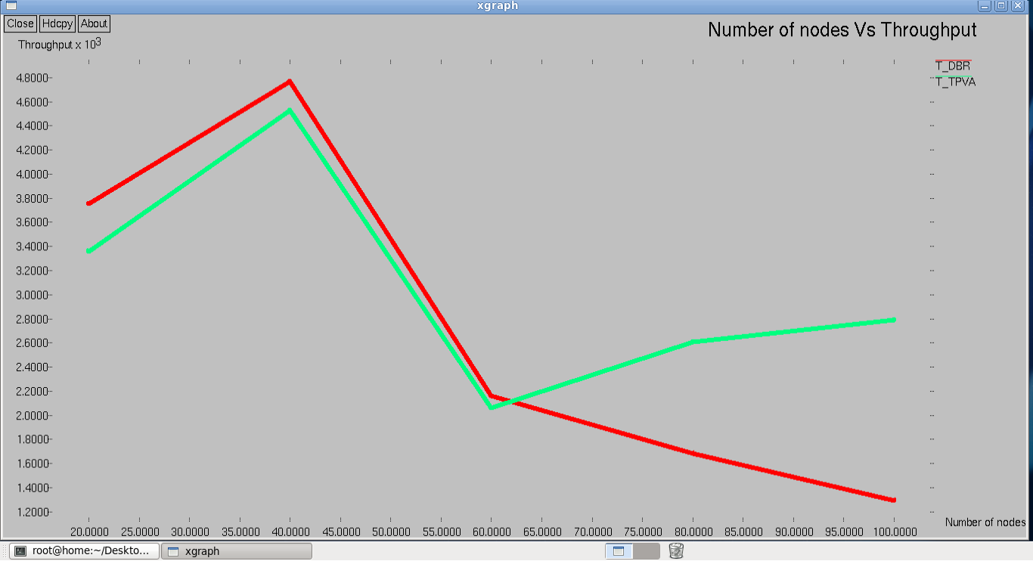
RESULTS

Slide 11
Thank you

